Slide 1


@sarabs3

Slide 2

Sarabjeet Singh
Founder, Organizer and Speaker at React Chandigarh.
Open-source enthusiast with 8 years of industry experience.
Currently working as a Senior Software Engineer at Ucreate.
@sarabs3

Slide 3

@sarabs3

Slide 4

Yash Gupta
16y old
Speaker at React India 2019
Student, freelancer
Github https://github.com/yashguptaz
@sarabs3

Slide 5
OPEN SOURCE
Open source empowers us to freely study, improve the software/code,
And distribute your improvements to the public so ultimately everyone benefits.
@sarabs3

Slide 6
BENEFITS OF OSS
@sarabs3

Slide 7
AVAILABILITY
With open source software, there is no barrier to trying out the software with all of its functionality. You don't have to ask anyone for permission to evaluate the software for future use, to experiment with it, or just to have fun with it.
@sarabs3

Slide 8
SUSTAINABILITY
Software these days heavily depends on other libraries and nobody wants to hang in the middle when vendor decided to drop support of one of your dependencies. The source code being available for anyone to modify means you are not relying on a single vendor for long-term maintenance.
@sarabs3

Slide 9
IDENTIFY AND
ATTRACT TALENT
Enterprises can easily identify potential recruits based on the open record of their contributions to the technology they are interested in. Conversely, candidates can easily identify with the open source technologies an organization is using.
@sarabs3

Slide 10
TRANSPARENCY
Access to the source code means that users are able to look under the hood and understand by themselves how the software works, or why it behaves the way it does.
@sarabs3

Slide 11
ADOPTS TO FUTURE NEEDS
Organizations that engage in the open source communities are more efficient,
anticipate changes, or can voice concerns about decisions that would adversely
affect them. They can make sure the software adapts to future needs by growing
the features they will need tomorrow.
@sarabs3

Slide 12
THE COMMUNITY
@sarabs3
Notes:
Microsoft moves from being a proprietary to open source by acquiring Github, developed VS Code, Typescript etc.

Slide 13


Git & Github
@sarabs3

Slide 14

Git
Distributed version control system
Free and open source
Nearly every operation is local
@sarabs3

Slide 15
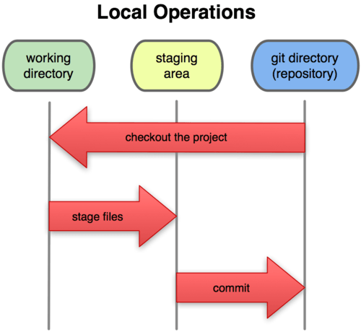
Three States of Git
Working Directory
Staging Area
Repository
@sarabs3

Slide 16
Downloading Git
Install git in your local computer.
Windows: https://git-scm.com/download/win
Linux: apt-get install git
Mac: https://git-scm.com/download/mac
@sarabs3

Slide 17
Basic Usage of Git
Git init: To initialize git inside your directory.
Git config --global user and email: To set up local user information that git will use to create logs.
Git add: To move files from working directory to staging
Git commit -m “message”: To commit your changes with a message so the other developers will understand what does the commit contains. Try to be specific and brief.
Git log: To view the logs.
@sarabs3

Slide 18
Sending changes
to server
Git fetch: fetch remote repository changes to local.
Git Merge: Merge remote changes with local.
Git pull: To pull the latest changes from remote repository and merge them. Git pull command use git fetch and git merge.
Git Push: To push the latest changes to remote repository.
@sarabs3

Slide 19

Github
Github is a cloud platform that built around Git tool.
It has user management features.
It focuses on centralised source code hosting.
Microsoft acquires Github in 2018.
@sarabs3

Slide 20
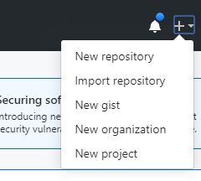
Using Github
In your browser, go to www.github.com
Create an account by signing up.
Create a new repository
Update remote directory link in your repo with git remote add origin <url> command
@sarabs3

Slide 21


Cloning and Forking
@sarabs3

Slide 22
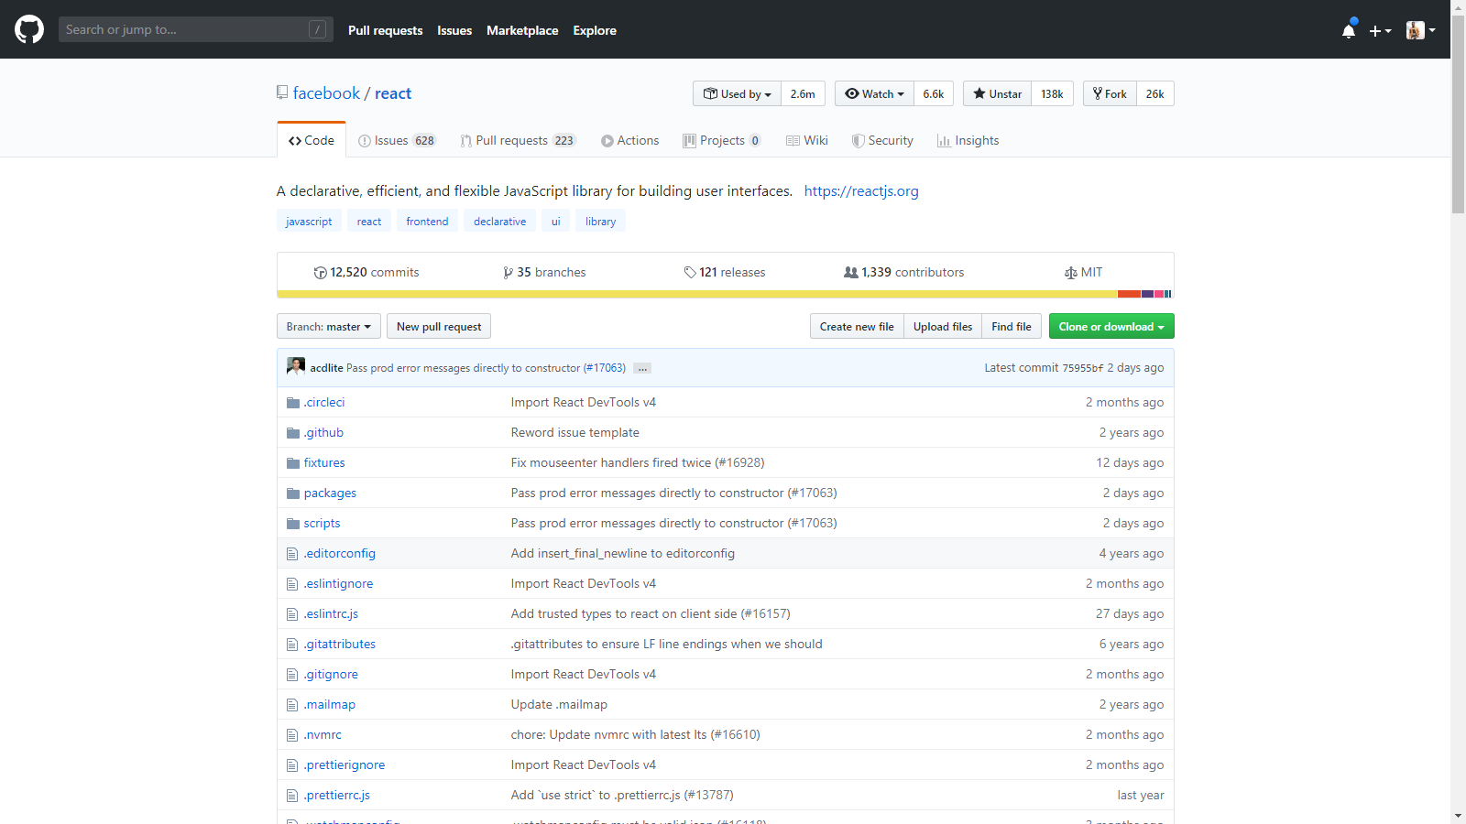
@sarabs3

Slide 23
Branches
Branches are useful to run development of features parallely.
By default all of the source code of a repo lies on master branch and it also referred as production ready code, as it is what all of the public user will get when they clone your repo.
One of the use case of branch is when you are working on a new feature and on development done it merge back into the master. In that way, it will not mess up main branch code while development.
@sarabs3

Slide 24
Pull Request
Pull Request are used to notify the author/creator of the repo about
the change that you made and details about it. So the author can merge
your changes into the main repo and all of the users will get it.
@sarabs3

Slide 25
Thank You!
Follow me.
@sarabs3

